Slide 1
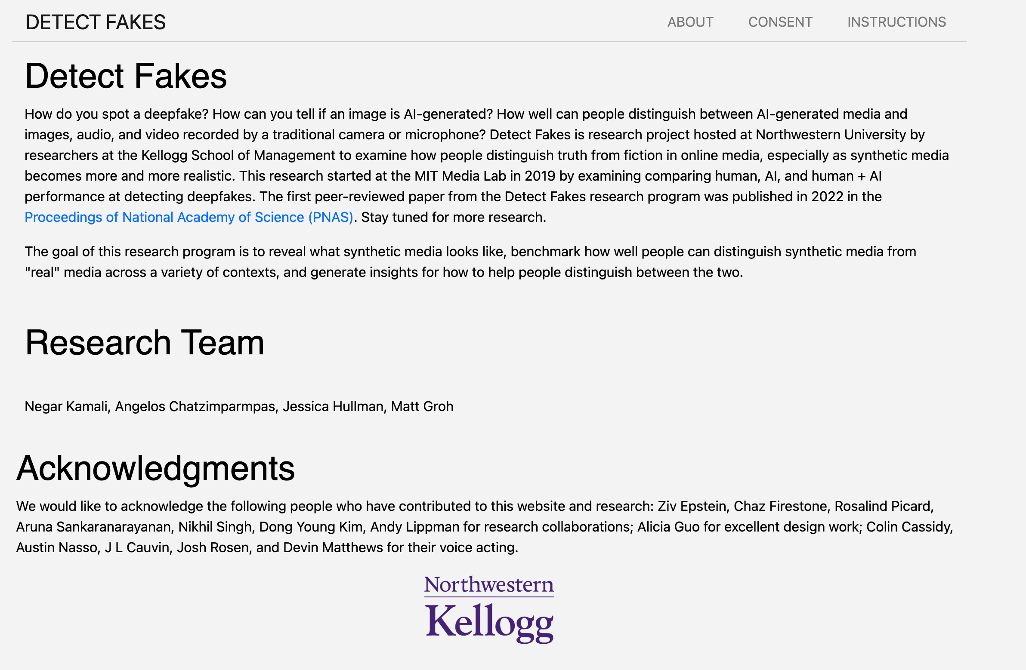
https://detectfakes.kellogg.northwestern.edu/

Slide 2

https://detectfakes.kellogg.northwestern.edu/

Slide 3

https://detectfakes.kellogg.northwestern.edu/

Slide 4

https://detectfakes.kellogg.northwestern.edu/

Slide 5

https://detectfakes.kellogg.northwestern.edu/

Slide 6

https://detectfakes.kellogg.northwestern.edu/

Slide 7

https://detectfakes.kellogg.northwestern.edu/

Slide 8

https://detectfakes.kellogg.northwestern.edu/

Slide 9

https://detectfakes.kellogg.northwestern.edu/

Slide 10
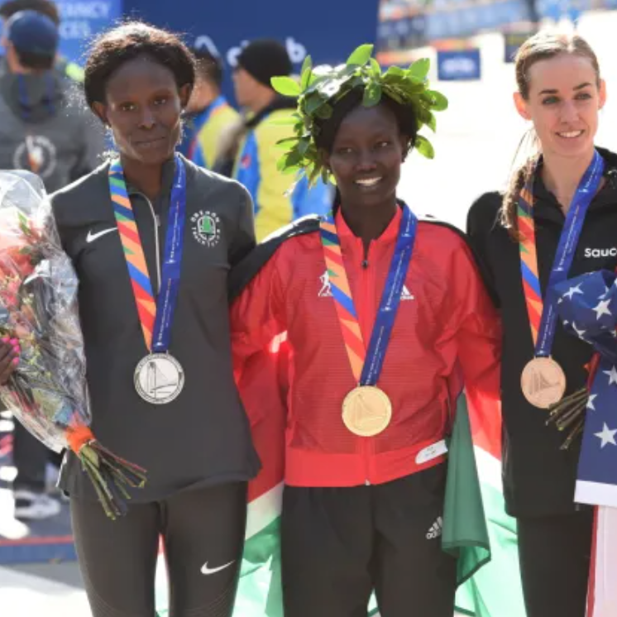
https://detectfakes.kellogg.northwestern.edu/

Slide 11
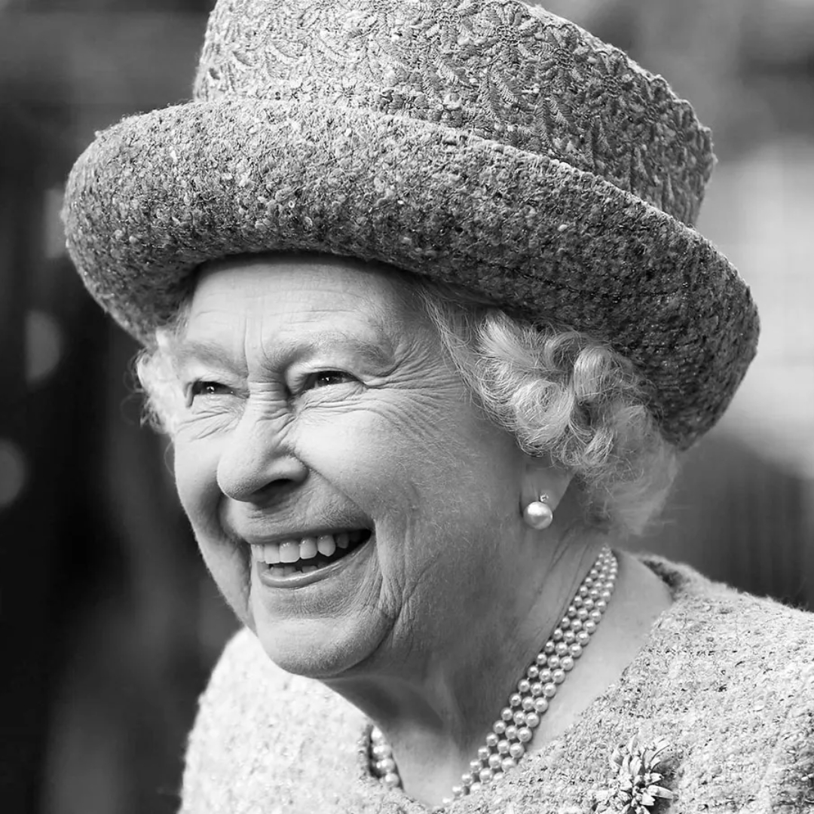
https://detectfakes.kellogg.northwestern.edu/

Slide 12

https://detectfakes.kellogg.northwestern.edu/

Slide 13

https://detectfakes.kellogg.northwestern.edu/

Slide 14
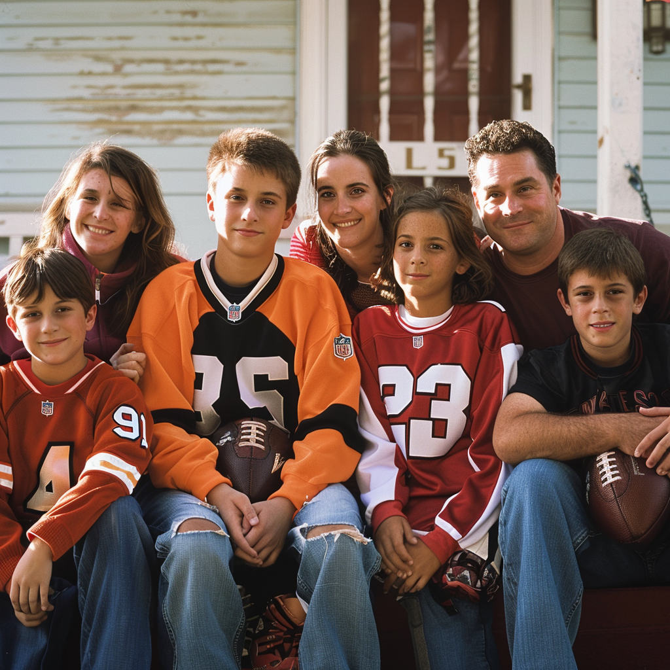
https://detectfakes.kellogg.northwestern.edu/

Slide 15

https://detectfakes.kellogg.northwestern.edu/

Slide 16

https://detectfakes.kellogg.northwestern.edu/

Slide 17

https://detectfakes.kellogg.northwestern.edu/

Slide 18

https://detectfakes.kellogg.northwestern.edu/

Slide 19

https://detectfakes.kellogg.northwestern.edu/

Slide 20

https://detectfakes.kellogg.northwestern.edu/

Slide 21
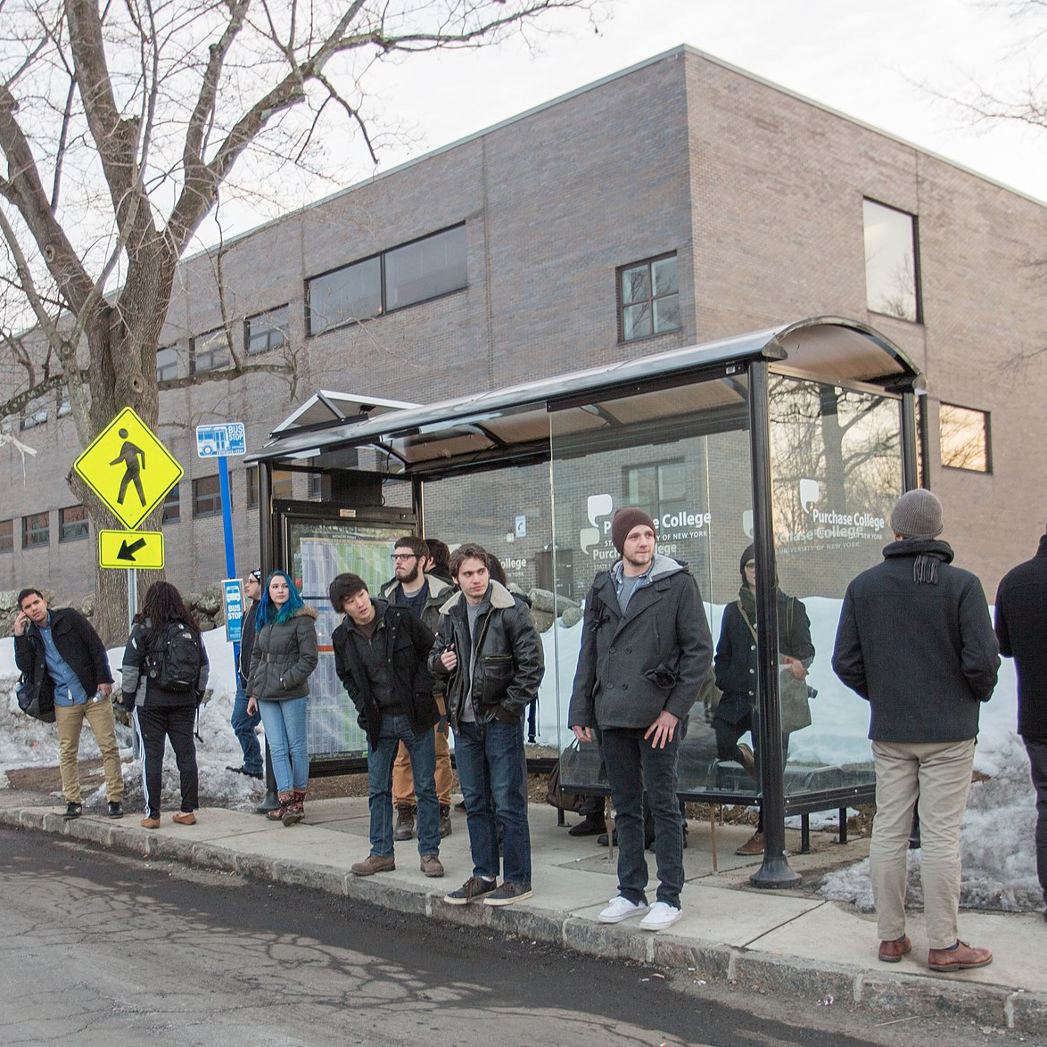
https://detectfakes.kellogg.northwestern.edu/

Slide 22

https://detectfakes.kellogg.northwestern.edu/

Slide 23

https://detectfakes.kellogg.northwestern.edu/

Slide 24
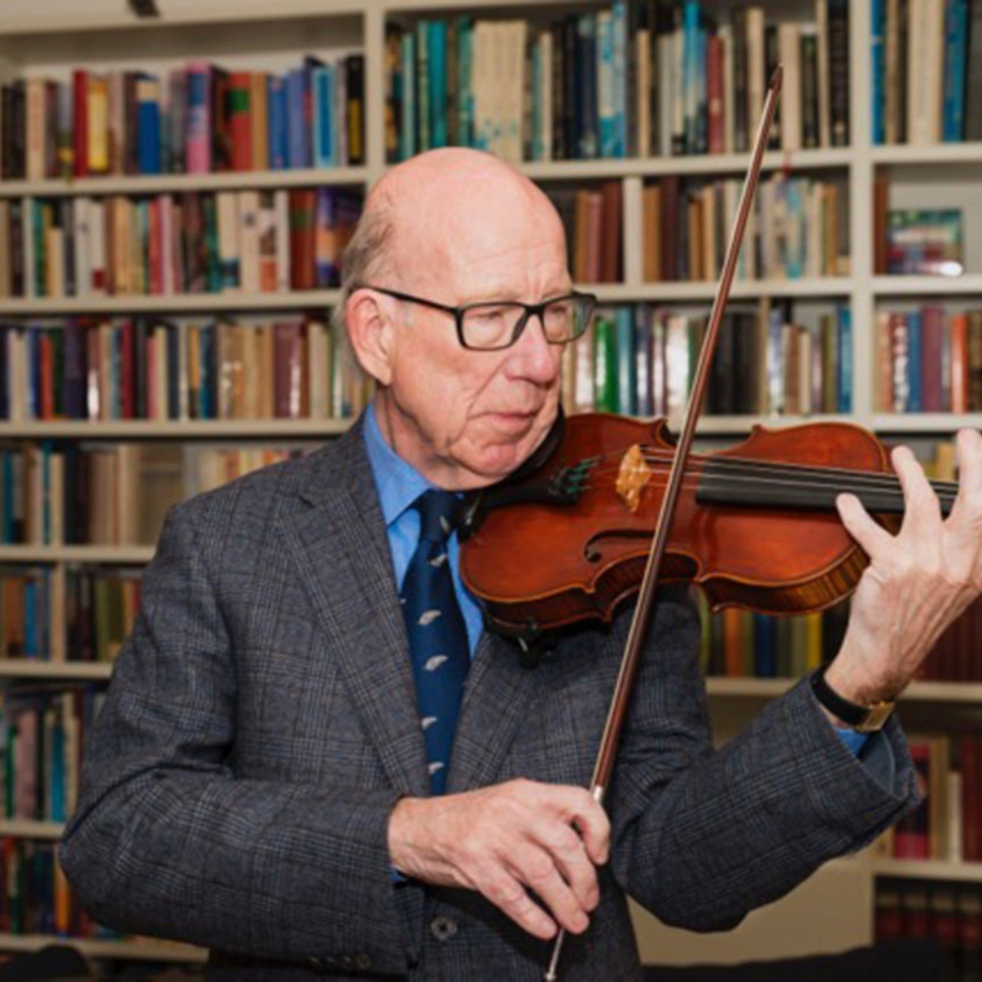
https://detectfakes.kellogg.northwestern.edu/

Slide 25

https://detectfakes.kellogg.northwestern.edu/

Slide 26

https://detectfakes.kellogg.northwestern.edu/

Slide 27

https://detectfakes.kellogg.northwestern.edu/

Slide 28
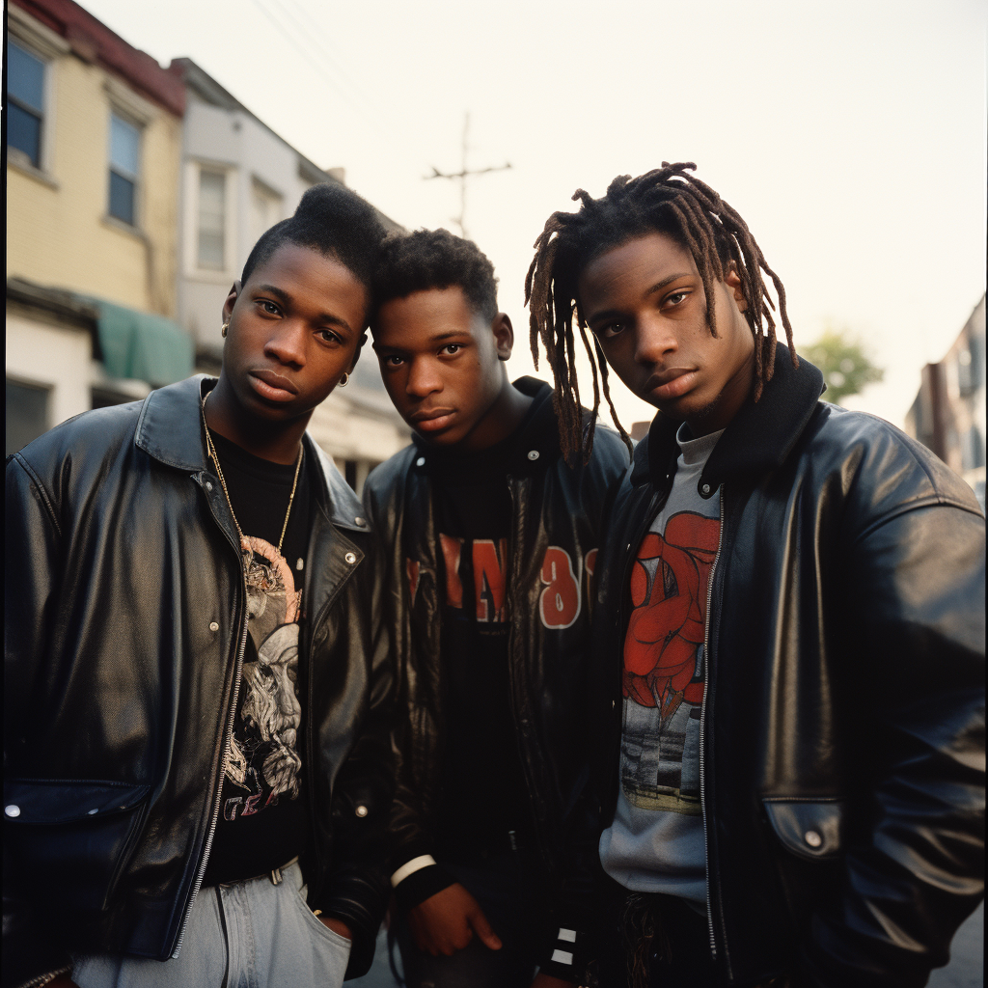
https://detectfakes.kellogg.northwestern.edu/

Slide 29

https://detectfakes.kellogg.northwestern.edu/

Slide 30

https://detectfakes.kellogg.northwestern.edu/

Slide 31

https://detectfakes.kellogg.northwestern.edu/

Slide 32
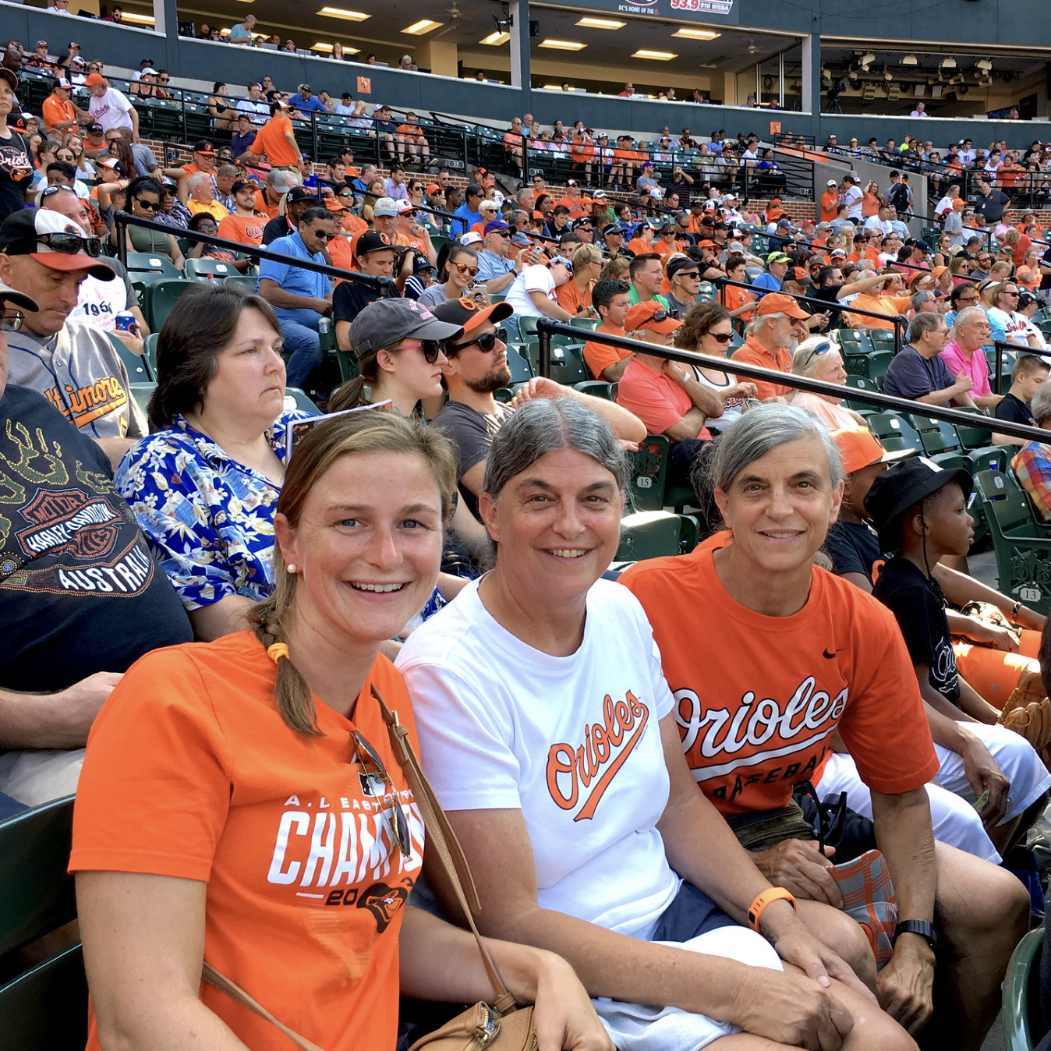
https://detectfakes.kellogg.northwestern.edu/

Slide 33
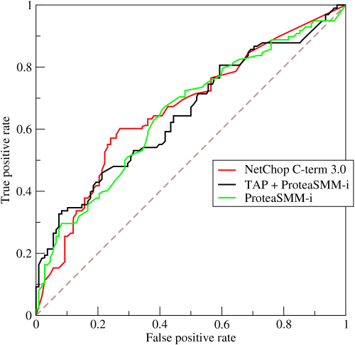
HW: ROC out your deepfake results
Generate your (FPR, TPR) for fake scores 1–5
Plot a curve and measure (or estimate) AUC
TPR = TP / (TP + FN)
FPR = FP / (FP + TN)
https://upload.wikimedia.org/wikipedia/commons/6/6b/Roccurves.png

Slide 34
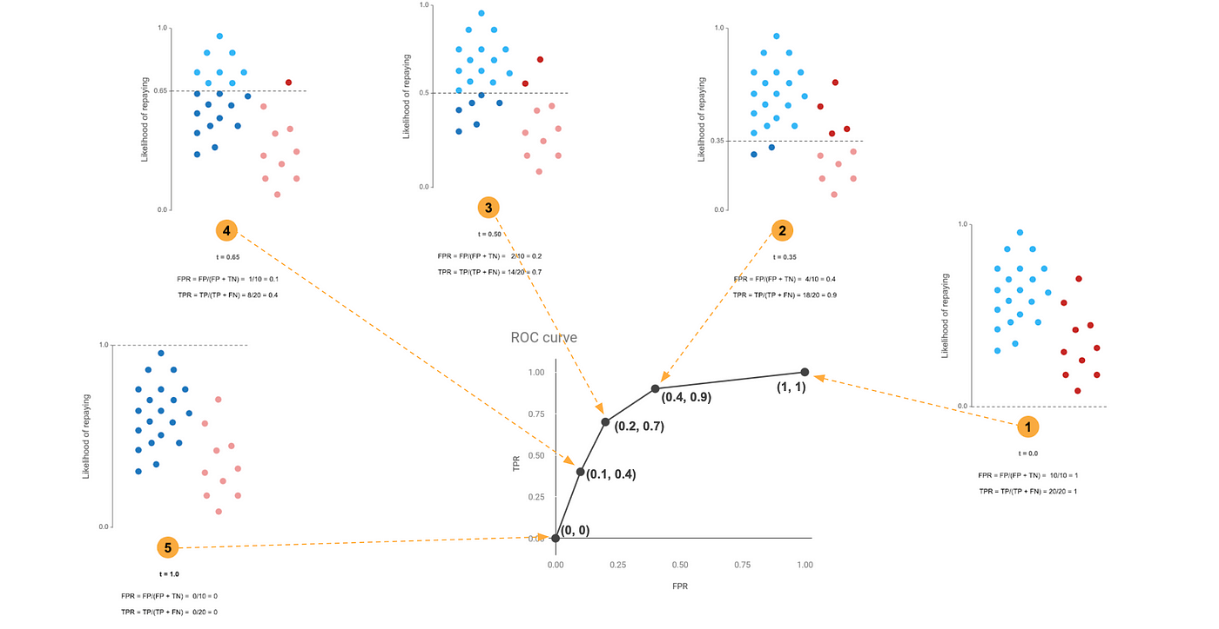
ROC curves explained visually
https://towardsdatascience.com/understanding-the-roc-curve-in-three-visual-steps-795b1399481c

Slide 35

2022
https://dnm.nflximg.net/api/v6/2DuQlx0fM4wd1nzqm5BFBi6ILa8/AAAAQYwP3BYZ2Ri_-P-sY4_vtR9_fv6KPptWKKniY2_VxxOzqurvjAbe7bi4XPq2NbcH4vw99f1gFDyU_TZe7bkeHOBKNYccZkoFBoRsCHFtqWFtHPYk16RT26YMxUs8PffGpvROrvismA_Kt8PHRAuviZLp.jpg?r=b5e

Slide 36
2023
https://dnm.nflximg.net/api/v6/2DuQlx0fM4wd1nzqm5BFBi6ILa8/AAAAQYwP3BYZ2Ri_-P-sY4_vtR9_fv6KPptWKKniY2_VxxOzqurvjAbe7bi4XPq2NbcH4vw99f1gFDyU_TZe7bkeHOBKNYccZkoFBoRsCHFtqWFtHPYk16RT26YMxUs8PffGpvROrvismA_Kt8PHRAuviZLp.jpg?r=b5e

Slide 37
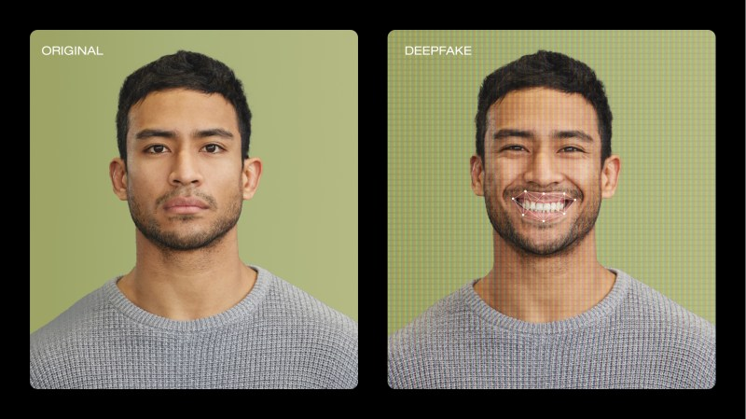
2024
https://vimeo.com/blog/post/video-deepfakes/

Slide 38
Answers…

Slide 39
Real
https://detectfakes.kellogg.northwestern.edu/

Slide 40
Fake
https://detectfakes.kellogg.northwestern.edu/

Slide 41
Fake
https://detectfakes.kellogg.northwestern.edu/

Slide 42
Real
https://detectfakes.kellogg.northwestern.edu/

Slide 43
Fake
https://detectfakes.kellogg.northwestern.edu/

Slide 44
Real
https://detectfakes.kellogg.northwestern.edu/

Slide 45
Fake
https://detectfakes.kellogg.northwestern.edu/

Slide 46
Real
https://detectfakes.kellogg.northwestern.edu/

Slide 47
Real
https://detectfakes.kellogg.northwestern.edu/

Slide 48
Real
https://detectfakes.kellogg.northwestern.edu/

Slide 49
Fake
https://detectfakes.kellogg.northwestern.edu/

Slide 50
Fake
https://detectfakes.kellogg.northwestern.edu/

Slide 51
Fake
https://detectfakes.kellogg.northwestern.edu/

Slide 52
Fake
https://detectfakes.kellogg.northwestern.edu/

Slide 53
Real
https://detectfakes.kellogg.northwestern.edu/

Slide 54
Fake
https://detectfakes.kellogg.northwestern.edu/

Slide 55
Fake
https://detectfakes.kellogg.northwestern.edu/

Slide 56
Fake
https://detectfakes.kellogg.northwestern.edu/

Slide 57
Real
https://detectfakes.kellogg.northwestern.edu/

Slide 58
Real
https://detectfakes.kellogg.northwestern.edu/

Slide 59
Real
https://detectfakes.kellogg.northwestern.edu/

Slide 60
Real
https://detectfakes.kellogg.northwestern.edu/

Slide 61
Real
https://detectfakes.kellogg.northwestern.edu/

Slide 62
Real
https://detectfakes.kellogg.northwestern.edu/

Slide 63
Fake
https://detectfakes.kellogg.northwestern.edu/

Slide 64
Fake
https://detectfakes.kellogg.northwestern.edu/

Slide 65
Fake
https://detectfakes.kellogg.northwestern.edu/

Slide 66
Fake
https://detectfakes.kellogg.northwestern.edu/

Slide 67
Real
https://detectfakes.kellogg.northwestern.edu/

Slide 68
Fake
https://detectfakes.kellogg.northwestern.edu/

Slide 69
Real
https://detectfakes.kellogg.northwestern.edu/

